Slide 1
Communications and Pre Game

Slide 2
1. Communication is what makes a Team Strong
2. The Biggest Communication problem is we do not listen to
understand we listen to reply
3. Consistency and Communication is really everything
4. Communication is the real work of Leadership
5. People may HEAR your words but they FEEL your ATTITUDE

Slide 3
Professionalism
The skill good judgment and polite behavior that is expected from a person who is qualified to do a job.
5 Important keys to being a True Professional
Character
Attitude
Excellence
Competency
Conduct

Slide 4
Professionals are:
Trustworthy
Competent
Respectful
Act with Integrity
Considerate
Empathetic
Courteous
Dependable
Cooperative
Committed
Accountable
Supportive

Slide 5
1. DON’T BE IMPATIENT WORK HARD AND PUT IN SINCERE GENUINE EFFORT
2. WHY DO YOU THINK YOU’RE READY
3. FIND A MENTOR / BE A MENTOR
4.LET OTHERS SOUND YOUR HORN / THE SOUND WILL TRAVEL FAR
5. LET THE WORK YOU PUT IN SPEAK FOR ITSELF
6. THERE ARE THINGS THAT YOU HAVE TOTAL CONTROL OF ( attitude, work ethic, effort )
7. DON’T CUT CORNERS IN YOUR DEVELOPMENT
8. FIND WHAT WORKS FOR YOU BE A SPONGE SOAK UP INFO AND KEEP WHAT WORKS
9. WHEN YOUR TIME COMES BE READY
10. IT’S ALWAYS WHAT’S RIGHT AND NOT WHO’S RIGHT

Slide 6
OFFICIATING PHILOSOPHY’S
Follow the Officiating Guidelines / not your own
UNDERSTAND THE POE / AND HOW TO APPLY THEM
OFFICIALS HAVE TO BE ON THE SAME PAGE
DON’T HAVE YOUR OWN AGENDA
KNOW THE RULES ( Somebody will be better prepared ( listen )
GIRLS GAME vs BOYS GAME ( they are different )
DON’T JUST HAVE THE LET THEM PLAY ATTITUDE ( issues will arise)
COACHES AND PLAYERS WILL ADJUST
RULES RULES RULES ( not yours the books )
WHERE YOU ARE IS PROBABLY WHERE YOU SHOULD BE
PRE-GAMES ARE VERY IMPORTANT (even if just for a few minutes )

Slide 7
Conclusion
1. Start with Self RESPECT
2. leave Personal Unexpressed feelings at the door before entering the Gym
3. Determine Your Values
4. Attention to HOW YOU communicate
5. Keep PERSONAL ISSUES AT HOME
6. Be Polite in speech and Body Language
Take a Leadership role whenever possible

Slide 8
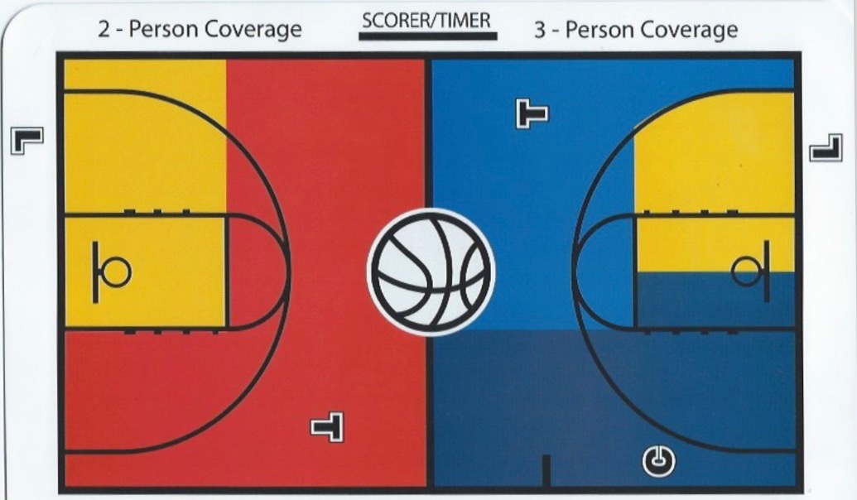

Slide 9
Five Points to a Great Game
Trust your Partners ( Global Awareness / Local Understanding )
Stay in your primary ( exception / obvious call )
Clock Management ( All Officials )
Work the System ( Understand the NHF coverage )
Referee the Defense ( beware of the Offense )
2. New Rules
Talk about any Rule Changes ( New and Past Year )
3. Scoring / Timing Procedures
Correctable Errors
Technical Fouls
Atypical Plays ( Dbl fouls, Technical etc.)
4. Points of Emphasis
Hand Checking, Post Play, POV,
New and Past Year
5. Tempo Setting Plays
Hand Checks, Traveling, 3 Sec, Illegal Screens, Taunting, Good Block Shots, Block/Charges, etc ( WE SET THE TEMPO )

Slide 10
6. Game Management
Dead Ball Management ( coaches, players, bench personnel )
Be Professional at ALL times ( answer questions, NO Response to Statements )
Unusual situations ( correctable errors, timing etc. have BOTH Coaches available)
Stay with Plays ( especially hard /legal Fouls )
Slow Down Communicate with your Partners ( entire Game )
Where are Administrators ( in the event there is an OFF THE FLOOR SITUATION )
Game Clocks ( be aware of non starts-early starts ( there is no do over rule )
Fights Be aware of rivalry matchups as well as individual matchups
Use your voice and whistle to get players attention
DON’T TOUCH HOLD OR GRAB PLAYERS ( Liability concerns )
Be aware of the Bench area ( know who can come off to help )
Know how to access penalties ( shots, ejections, etc )
7. Clock Management( ALL OFFICIALS SHOULD BE AWARE )

Slide 11
8. Rotation and Floor Coverage
referee NEW Responsibility after rotation ( T, L C )
Know coverage area as T, L, C
9. Lead Positions
Wide and Close Down
Look for reasons to rotate ( Zones don’t eliminate need to rotate )
Use your voice ( preventive officiating )
Get good rebounding angles on shots ( work wide on jump shots/ close down
on drives to the basket )
Relax ( sneak a peak on 3s from the corner )
10. Center Position
Referee plays to the basket
look for curl plays
Find a good starting point ( not to high/low )
The ball and players determines your movement ( don’t get straight lined )
Double whistles in the lane

Slide 12
11. Trail Position
Find a good starting point ( 28ft mark and work from there )
Look for curl plays ( referee where the L can’t )
Referee OFF the ball when the L is on the ball ( eye contact )
Referee on the floor ( not standing on the sideline )
Don’t work to high / low keep ALL players within the TRIANGLE
Basket interference and Goal tending
Know your Lines ( side/center court )
12. Referee Strong
When the Ball and plays go away from you
Know PRIMARY / SECONDARY
13. Double Whistles
MAY go to PRIMARY ( make eye contact )
14. CALL THE OBVIOUS
Don’t Guess ( get the play right )

Slide 13
15. HAVE A PATIENT WHISTLE ( on block shots and rebounding plays )
16. Illegal Screens ( there is NO such thing as a MOVING SCREEN )
where and how they are set
impact on the play
did the defender PUSH through
did the OFFENSIVE player have their BASE outside the shoulders
Time and distance
Blind screen /Side screen
17. Tripping
18. Review ATYPICAL situations
Fights ( review rule 10; participate / non-participate )
Intentional Fouls
Flagrant fouls ( personal / Technical / ball placement )
Double Personal
Double Technicals

Slide 14
19. End of Quarters / Half / Game
who will take ending shot
last few minutes get together on time outs
when do we NOT rotate to maintain transition integrity
everyone has an opinion on shot especially 3 in the corners
when / how do we leave the floor
check the book, arrow, etc
20. Be aware of
Team and personal fouls
Score and time
Always continue communications
21. Concentrate / Focus until the final horn

Slide 15
Discuss the following
Opening Jump ball situations - possession arrow
Warning to Coaches / Players ( communicate )
Help Areas / out of bounds, 3pt shots, Intentional Fouls
changing 3/2 and vice versa
Stay with shooters
Blood situations, Injuries, contacts ( know the time frame )
Pass and crash ( shot or pass )
Responsibility for subs
Disqualified player ( time frame )
Crew Support of partners calls
FIVE ITEMS FOR THAT GREAT GAME
Teamwork
Communicate
Be Approachable
Be Professional
BE A GREAT GAME MANAGER

Slide 16
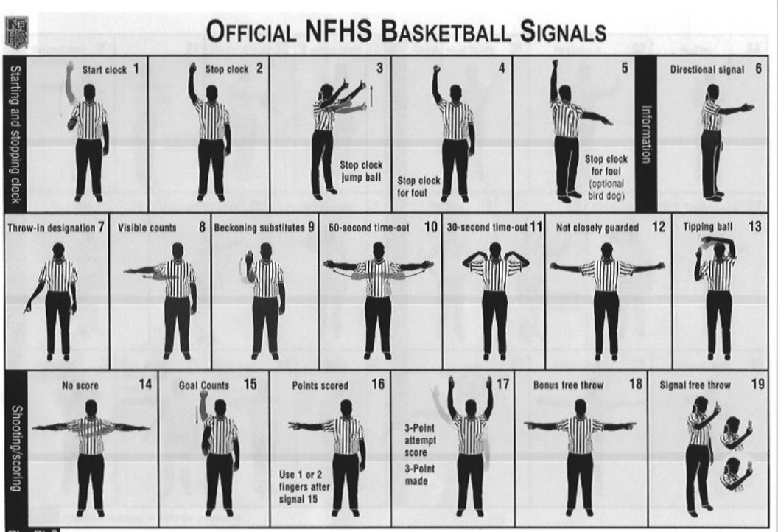

Slide 17
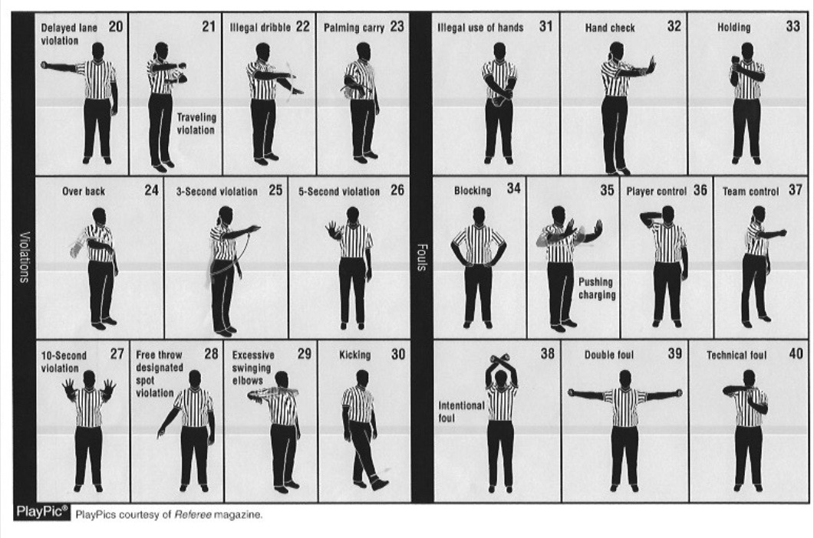

Slide 18
1. Identifying Names may be placed on a Jersey
a) diagonally, b) horizontally, )c vertically, )d all the above
2. The Official shall report the foul offenders # with:
a) no Hands, b) One Hand, c) two hands, d) any of the above
3. By rule the Coaching Box may be extended with:
a) painted lines, b) tape, c) a and b, d) neither a or b
4. With no prior warnings, the team A head coach steps out the coaches
box and instructs a player on the court: an Official shall:
a) issue a warning, b) issue a technical foul, c) either a or b, d) neither
5. The Coaching box may start parallel to the end line: T or F
6. During live play and before any warnings has been issued, the Team
A coach steps onto the court and protests a call by yelling profanity
heard by an Official across the court: a) warning, b) Technical, c) A or B
neither A or B

Slide 19
7. The Coaches Box length is: a) maximum 14, b) May be altered by
State Assoc., c) a and b, d) neither a or b
8. The jersey back shoulder area panel may be used to place a name
T or F

Slide 20
3-4-4 Identifying name(s) shall adhere to the following:
a. Lettering with school name, nickname, logo, Player’s name or
abbreviation of official name shall be placed Horizontally on the jersey
b. The panel in the shoulder area of the jersey on the back may be used
for placing an identifying name as well.

Slide 21
4-48 NEW: WARNING FOR COACHES/TEAM CONDUCT
A warning to a coach/team for misconduct is an administrative
procedure by an official, which is recorded in the scorebook by the
scorer and reported to the Head Coach
Art. 1 for conduct described in rule 10-5 a-f; 10-5-2; 10-5-4
The official shall warn the head coach unless the offense is judged to
be major, in which case a Technical foul shall be assessed. NOTE:
A WARNING IS NOT REQUIRED PRIOR TO CALLING A TECHNICAL
Art. 2 for the first violation of rule 10-6-1, the official shall warn the Head
Coach unless the offense is judged to be major, in which case a T shall
be assessed. NOTE: A WARNING IS NOT REQUIRED PRIOR TO
CALLING A TECHNICAL FOUL

